Slide 1
Polymer Chemistry
Polymer structure

Slide 2
Polymers
The word polymer has a Greek origin. Which means many
units (parts). Polymer is defined as a chemical substance of a
high molecular mass formed by the combination of a
large number of, called monomers simple molecules.
e.g.
CH2=CH2 — (CH2-CH2)n
ethylene polyethylene

Slide 3
Monomers:
These simple molecules or repeating units which combine to give polymers are called monomers.
The process of joining together of a large number of the monomers is polymerization termed as polymerization.
A polymer formed from one type of monomers is called a homopolymer, e.g., polyethylene, PVC, polyacrylonitrile, etc.
A polymer formed from two or more different monomers is called copolymer e.g., Nylon-6,6, polyester, bakelite, etc

Slide 4
Polymerisation
The process by which the monomers get combined and transformed into polymers. is known as polymerisation.
n [Monomer] → Polymer
Difference between Polymers and Macromolecules
Polymers are also called macromolecules due to their
large size but converse is not always true. A macromolecule may not contain monomer units, e.g., chlorophyll (C₅₅H₇₂O₅N₄Mg) is a macromolecule but not a polymer since there are no monomer units present so we can conclude that all polymers are macromolecules while all macromolecules may not be polymers in nature.

Slide 5
Classification of Polymers Based on Source of Origin
Natural polymers:
Natural polymers are polymers which occur in nature and are existing in natural sources like plants and animals.
Some common examples are Proteins (which are found in humans and animals alike), Cellulose and Starch (which are found in plants) or Rubber (which we harvest from the latex of a tropical plant ).

Slide 6
Synthetic polymers
Synthetic polymers are polymers which humans can artificially create/synthesize in a lab. These are commercially produced by industries for human necessities.
Some commonly produced polymers which we use day to day are Polyethylene (a mass-produced plastic which we use in packaging) or Nylon Fibers (commonly used in our clothes, fishing nets etc.

Slide 7
Semisynthetic polymers:
Semi-Synthetic polymers are polymers obtained by making modification in natural polymers artificially in a lab. These polymers formed by chemical reaction (in a controlled environment) and are of commercial importance.
Example: Vulcanized Rubber ( Sulphur is used in cross bonding the polymer chains found in natural rubber) Cellulose acetate (rayon) etc.

Slide 8
Classification of Polymers Based on Structure
Linear polymers;
These are the polymers in which the monomer units are linked to one another to form long linear chains. These linear chains are closely packed in space. The close packing results in high densities, tensile strength and high melting and boiling points.
Example: high density polyethene, nylon and polyesters are linear polymers

Slide 9
Branched chain polymers;
In such polymers, the monomer units are linked to form long chains with some branched chains of different lengths with source. As a result of branching ,
O they have low densities,
O low tensile strength
O as well as low melting and boiling points.
Some common examples of such polymers are low density polyethene, starch, glycogen etc.

Slide 10
Branching of polymers occurs by replacing some atoms from the polymer chain by substituents.
The properties of these polymers are mainly affected by the amount of branching.
The substituent is another polymer chain composed of covalently bonded monomer units. These side chains can be either short chains or long chains.

Slide 11
Different Types of Branched Polymers
Comb Polymer
According to the IUPAC gold book, a comb polymer is a polymer composed of comb macromolecules. In other words, it is composed of side chains on the same side of the backbone, and the polymer then appears like a comb.
Brush Polymer
This form of polymers looks like a brush where the backbone is substituted with side chains from different points. The density is high in these polymers.
Star-shaped Polymer

Slide 12
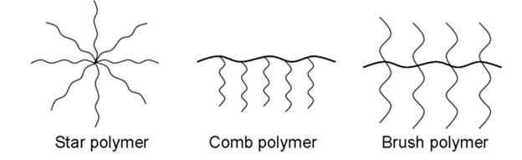
Figure

Slide 13
Crosslinked polymers,
In such polymers, the monomer units are linked together to form three dimensional network. These are expected to be quite hard, rigid and brittle.
Examples of cross linked polymers are bakelite, melamine-formaldehyde polymer etc.

Slide 14
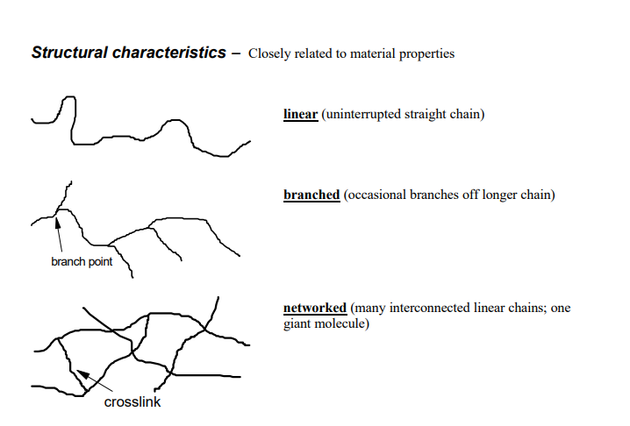

Slide 15
On the basis of Polymerisation
Addition polymers;
The polymers formed by the polymerisation of monomers containing double or triple bonds (unsaturated compounds) are called addition polymers. Addition polymers have the same empirical formula as their monomers.
Addition polymers can further be classified on the basis of the types of monomers into the following two classes

Slide 16
1.Homopolymers; The polymers which are obtained by the polymerisation of a single type of monomer are called homopolymers. Copolymers The polymers which are obtained by the polymerisation of two or more monomers are called copolymers
I CH2=CH2 — (CH2-CH2)n
ethylene polyethylene
2.The polymers which are formed by the combination of monomers with the elimination of small molecules such as water, alcohol, hydrogen chloride etc., are known as condensation polymers, e.g., nylon 6,6 is formed by the condensation of hexamethylene diamine with adipic acid. l

Slide 17
Classification Based on Molecular Forces
Intramolecular forces are the forces that hold atoms together within a molecule. In Polymers, strong covalent bonds join atoms to each other in individual polymer molecules. Intermolecular forces (between the molecules) attract polymer molecules towards each other.
Note that the properties exhibited by solid materials like polymers depend largely on the strength of the forces between these molecules. Using this, Polymers can be classified into 4 types:

Slide 18
i) Elastomers:
Elastomers are rubber-like solid polymers, that are elastic in nature. When we say elastic, we basically mean that the polymer can be easily stretched by applying a little force.
The most common example of this can be seen in rubber bands(or hair bands). Applying a little stress elongates the band. The polymer chains are held by the weakest intermolecular forces, hence allowing the polymer to be stretched. But as you notice removing that stress also results in the rubber band taking up its original form. This happens as we introduce crosslinks between the polymer chains which help it in retracting to its original position, and taking its original form. Our car tyres are made of Vulcanized rubber. This is when we introduce sulphur to cross bond the polymer chains.

Slide 19
ii) Thermoplastics:
Thermoplastic polymers are long-chain polymers in which inter-molecules forces (Van der Waal’s forces) hold the polymer chains together. These polymers when heated are softened (thick fluid like) and hardened when they are allowed to cool down, forming a hard mass. They do not contain any cross bond and can easily be shaped by heating and using moulds.
A common example is Polystyrene or PVC (which is used in making pipes).

Slide 20
iii) Thermosetting:
Thermosetting plastics are polymers which are semi-fluid in nature with low molecular masses. When heated, they start cross-linking between polymer chains, hence becoming hard and infusible. They form a three-dimensional structure on the application of heat. This reaction is irreversible in nature.
The most common example of a thermosetting polymer is that of Bakelite, which is used in making electrical insulation.

Slide 21
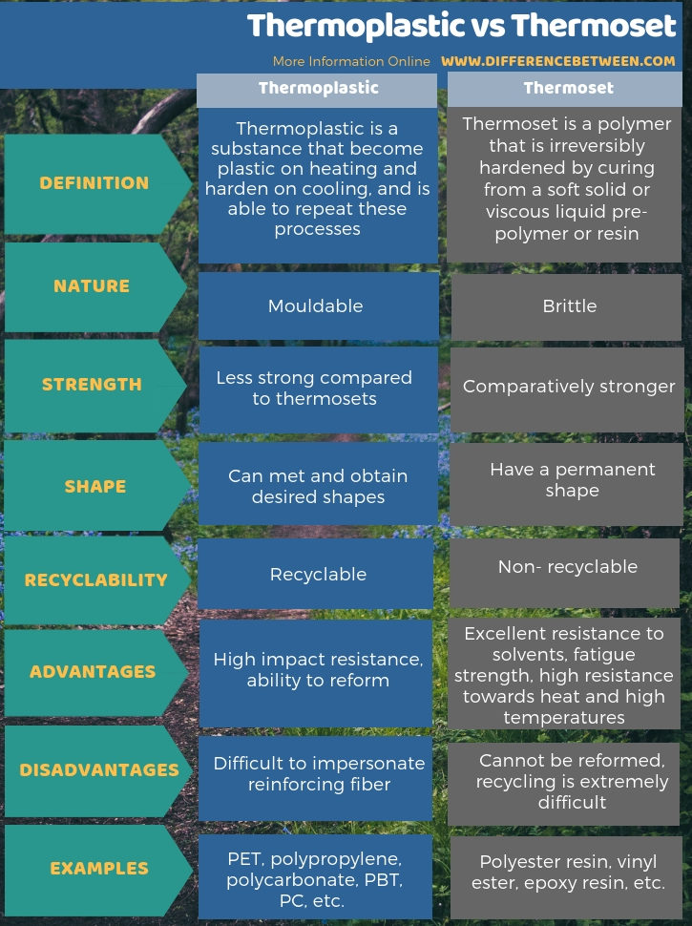

Slide 22
iv) Fibres:
In the classification of polymers, these are a class of polymers which are a thread like in nature,. They have strong inter-molecules forces between the chains giving them less elasticity and high tensile strength. The intermolecular forces may be hydrogen bonds or dipole-dipole interaction. Fibres have sharp and high melting points.
A common example is that of Nylon-66, which is used in carpets and apparels.
The above was the general ways to classify polymers. Another category of polymers is that of Biopolymers. Biopolymers are polymers which are obtained from living organisms. They are biodegradable and have a very well defined structure. Various biomolecules like carbohydrates and proteins are a part of the category.

Slide 23
Classification Based on Composition of Polymers
Homopolymer: A polymer resulting from the polymerization
of a single monomer; a polymer consisting substantially of
a single type of repeating unit.
Copolymer: When two different types of monomers are joined
in the same polymer chain, the polymer is called a copolymer.
. Many commercially important polymers are copolymers.
Examples include polyethylene-vinyl acetate (PEVA), nitrile rubber, and
acrylonitrile butadiene styrene (ABS). The process in which a copolymer is
formed from multiple species of monomers is known as copolymerization.
. Let's imagine now two monomers, which we'll call A and B. A and B can be made into a copolymer in many different ways

Slide 24
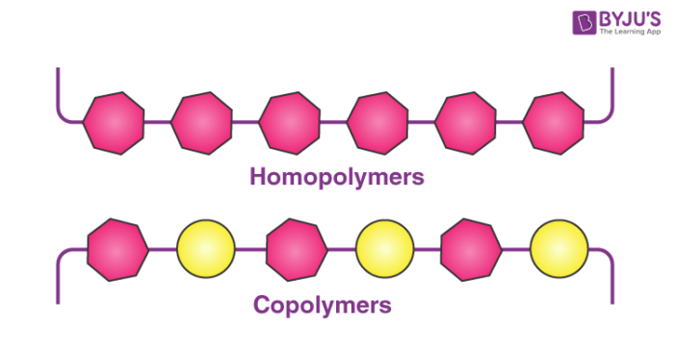
It is often used to improve or modify certain properties of plasticsustomi

Slide 25
Random copolymer:
In a random copolymer, the two monomers may follow in any order (figure below). The ratio of the monomers incorporated into the copolymer is a result of a combination of the properties of the monomers, the polymerization conditions and the conversion of the polymerization, to name a few variables.
For example, unless the two monomers have exactly the same reactivity, both with the other comonomer and with their own monomers, the ratio in the product will NOT be exactly 1-to-1. In fact, in most cases it's not, and this results in a change in the copolymer composition as the reaction proceeds. At the beginning, the more reactive monomer is incorporated more than the less reactive one.

Slide 26

Alternating Copolymers
Alternating copolymers contain a single main chain with alternating monomers.
The formula of an alternating copolymer made up of monomers A and B can be generalized to (-A-B-)_{n}.
Nylon 6,6 is an example of an alternating copolymer, consisting of alternating units of hexamethylene diamine and adipic acidseconds

Slide 27
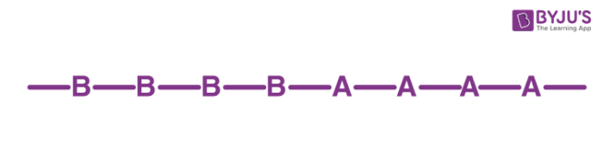
Block Copolymers
When more than one homopolymer units are linked together via covalent bonds, the resulting single-chain macromolecule is called a block copolymer.
The intermediate unit at which the two homopolymer chains are linked is called a junction block.
A diblock copolymer contains two homopolymer blocks whereas a triblock copolymer contains three distinct blocks of homopolymers.
An example of such a polymer is acrylonitrile butadiene styrene, commonly referred to as SBS

Slide 28
Graft Copolymer.
Graft copolymer is a type of copolymer in which one or more blocks of homopolymer are grafted as branches onto a main chain, meaning it is a branched copolymer with one or more side chains of a homopolymer attached to the backbone of the main chain

Slide 29
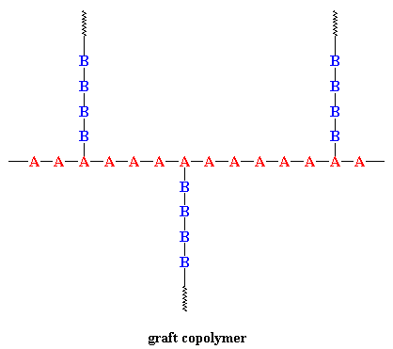

Slide 30
Preparation of Graft Copolymers
Chemical method
Radiation method
Photochemical method
Chemical method
Grafting through Chain transfer
First base polymer(polyacrylonitrile) is dissolved in monomer such as styrin and than an initiator is added. Two possible way of polymerization
Formation of polystyrene homopolymer
Grafting polystyrene onto polyacrylonitrile
In second one free radical created by interaction with initiator (some metals or non metal). The free radical produced on backbone of base polymer which result formation of graft copolymer

Slide 31
Synthesis of block polymerization
The synthesis of block copolymers often requires the use of living polymerization techniques. Meanwhile, graft copolymers can be synthesized using free-radical polymerization or other methods

Slide 32
. These side chains can have a different chemical structure and properties than the main chain.
This offers various beneficial properties such as: versatility of properties, enhanced compatibility/bonding with other materials according to graft chemistry, improved properties from graft selection, acting as toughening additives for other polymers, and aiding nanomaterial dispersion into other chemistries.

Slide 33
Synthesis of block polymerization
1. A second monomer can be polymerized onto existing polymer chain.
2. performed polymer chains could be combind with other polymeric chains with the aid of functional group

Slide 34
Classification based on Applications & Physical Properties
Fibers ¬If polymer is drawn into long filament like materiel whose length is at least 100 times it’s diameter, are said to be converted into fiber. ¬They have high tensile strength because of high intermolecular attractive force like Hydrogen bonding. ¬Highly crystalline. E.g. Nylon, Terylene.
Plastics ¬Polymer is shaped into hard and tough utility articles by application of heat and pressure, is known as plastics. ¬Here the intermolecular force between polymeric chains are intermediate between elastomers and fibers. ¬They are partially crystalline. E.g. Polystyrene, PVC, PMMA

Slide 35
Elastomers ¬They are solids with rubber like elastic properties
. ¬Here the polymeric chains are held together by the weakest intermolecular forces so they are highly amorphous in nature. ¬These weak binding forces permit them to be stretched. E.g. Natural rubber, BUNA-S, BUNA-N, Vulcanised rubber
Resins ¬Low molecular weight. ¬Polymers which are used as adhesives, sealants etc., in a liquid form are described as liquid resins. E.g. Epoxy adhesives and polysulphides sealants.

Slide 36
Degree of Polymerization
The degree of polymerization (DP or X_{n}) is defined as the number of monomer units in the polymer. It is calculated as the ratio of molecular weight of a polymer and molecular weight of the repeat unit. Number average DP and weight average DP are the two main types used for measuring the DP. Higher DP is desired for better mechanical properties .
Degree of polymerization=Mw/Mo
where M_{w} is the average molecular weight of the polymer and M_{o} is the molecular weight of the repeating unit or monomer.

Slide 37
Nomenclature
A very large number of different polymer structures are possible. In order to identify these as unambiguously as possible, it is important to have a robust nomenclature system. As is already evident, polymers that are prepared from one monomer unit are designated by attaching the prefix poly to the monomer name (e.g., polystyrene, polyethylene, and polypropylene);
However, when the monomer name consists of more than one word or is preceded by a letter or number, the monomer is enclosed by parentheses preceded by the prefix poly. For example, the polymer obtained from the polymerization of 4-chlorostyrene is poly(4-chlorostyrene) and that from vinyl acetate is poly(vinyl acetate)

Slide 38
Following IUPAC recommendations, copolymers are named by incorporating an italicized connective term between the names of monomers contained within parentheses or brackets or between two or more polymer names. The connective term designates the type of copolymer as indicated for six important classes of copolymers in Table
Type | Connective | Example
Unspecified | -co- | Poly[styrene-co-(methyl methacrylate)]
Statisticalª | -stat- | Poly(styrene-stat-butadiene)
Random | -ran- | Poly[ethylene-ran-(vinyl acetate)]
Alternating | -alt- | Poly[styrene-alt-(maleic anhydride)]
Block | -block- | Polystyrene-block-polybutadiene
Graft | -graft- | Polybutadiene-graft-polystyrene

Slide 39
Tacticity
.Tacticity (from Greek word taktikos "of or relating to arrangement or order") is the relative stereochemistry of adjacent chiral centers within a macromolecule.
The practical significance of tacticity rests on the effects on the physical properties of the polymer. The regularity of the macromolecular structure influences the degree to which it has rigid, crystalline long range order or flexible, amorphous long range disorder. Precise knowledge of tacticity of a polymer also helps understanding at what temperature a polymer melts, how soluble it is in a solvent and its mechanical properties.

Slide 40
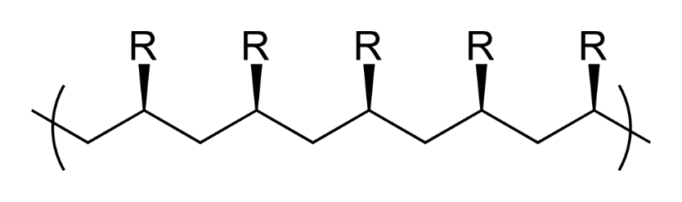
Isotactic polymers
Isotactic polymers are composed of isotactic macromolecules (IUPAC definition). In isotactic macromolecules all the substituents are located on the same side of the macromolecular backbone.
Polypropylene formed by Ziegler–Natta catalysis is an isotactic polymer. Isotactic polymers are usually semicrystalline and often form a helix configuration.

Slide 41
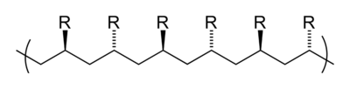
Syndiotactic polymers
In syndiotactic or syntactic macromolecules the substituents have alternate positions along the chain. The metallocene catalysis polymerization is crystalline with a melting point of 161 °C. Gutta percha is also an example for Syndiotactic polymer.

Slide 42
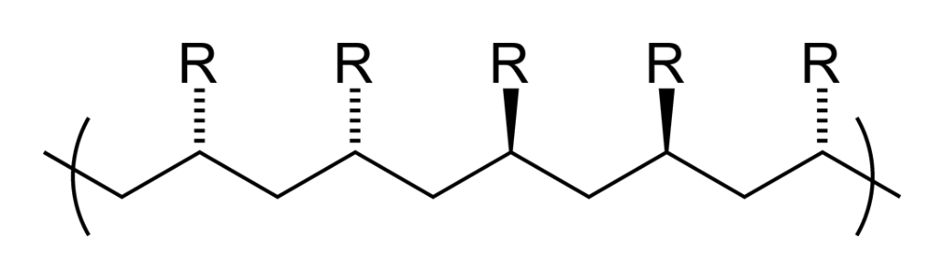
Atactic polymers
In atactic macromolecules the substituents are placed randomly along the chain.. With the aid of spectroscopic techniques such as NMR it is possible to pinpoint the composition of a polymer in terms of the percentages

Slide 43
Intermolecular forces in polymer
The intermolecular forces for polymers are the same as for small molecules. Because polymer molecules are so large, though, the magnitude of their intermolecular forces can vastly exceed those between small molecules. The presence of strong intermolecular forces is one of the main factors leading to the unique physical properties of polymers.

Slide 44
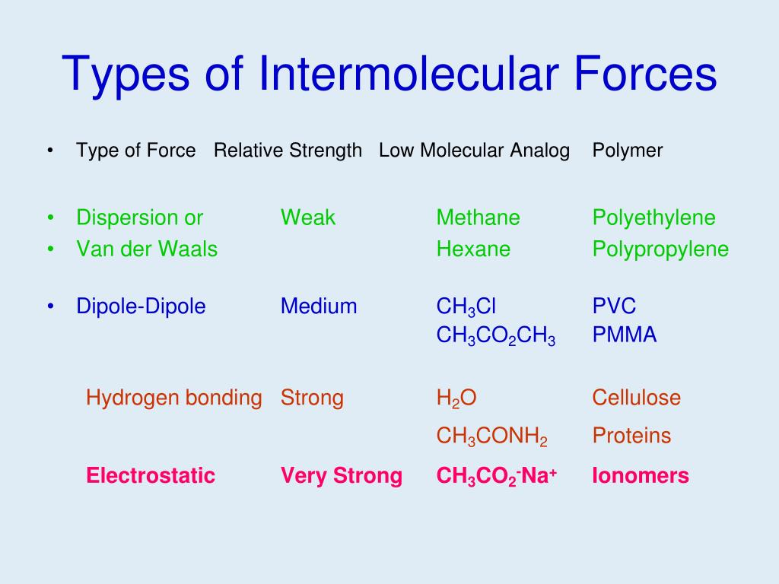

Slide 45
Dispersion Forces
Dispersion forces are due to instantaneous dipoles that form as the charge clouds in the molecules fluctuate. Dispersion forces, the weakest of the intermolecular forces, are present in all polymers. They are the only forces possible for nonpolar polymers such as polyethylene.
Dispersion forces depend on the polarizability of a molecule.
Larger molecules generally are more polarizable, so large polymers with high molecular weights can have significant dispersion forces.
Ultra high molecular weight polyethylene (UHMWPE), which has a molecular weight in excess of 3,000,000 g/mole, is used to make bulletproof vests.

Slide 46
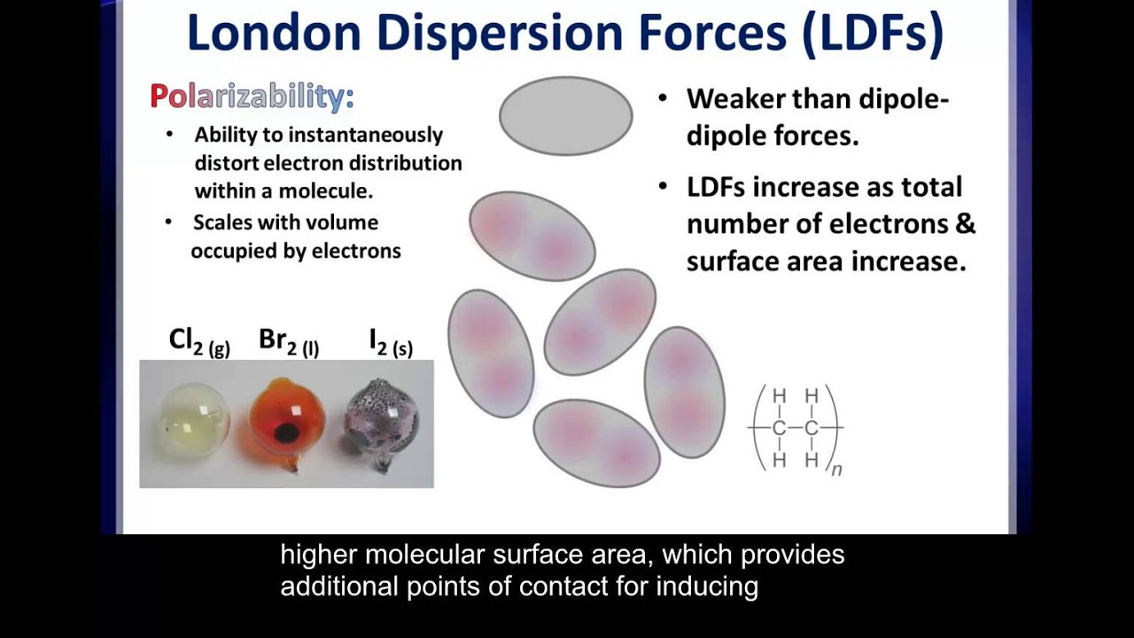

Slide 47
Dipole-Dipole Forces
Dipole-dipole forces result from the attraction between polar groups,
such as those in polyesters and vinyl polymers with chlorine pendant groups.

Slide 48
Hydrogen Bonding
Hydrogen bonding can take place when the polymer molecule contains -OH or -NH groups.
Hydrogen bonding is the strongest of the intermolecular forces.
Polymers such as poly(vinyl alcohol) and polyamides are hydrogen bonded.

Slide 49
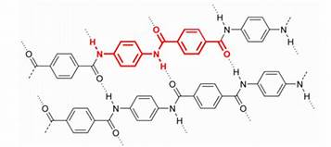

Slide 50
Ionic Bond
In chemical bonds, atoms can either transfer or share their valence electrons. In the extreme case where one or more atoms lose electrons and other atoms gain them in order to produce a noble gas electron configuration, the bond is called an ionic bond The bonding force in sodium chloride is a result of the electrostatic attraction between the two ions.
-Not common in polymeric materials (However, divalent ions are known to act as cross-links between carboxyl groups in natural resins.

Slide 51
CovalentBonding:
Exists in giant covalent and simple molecular compounds. A covalent bond is a shared pair of electrons,
with one electron being supplied by each atom in the bond.
Atoms share electrons in order to gain the
most stable electron configuration; that of a noble gas
Dative covalent bonds (Co-ordinate bonds) are formed when both of the electrons are donated by a single
species which is elehctron rich (a nucleophile) to a single electron deficient species (electrophile

Slide 52
Metallic Bonding:
This type of bonding exists in all metals. Metal atoms achieve stability by offloading their outer electrons to
a delocalised electron cloud, forming positive metal ions in the process.
The cloud of delocalised negative
electrons surrounds the positive metal ions holding them in place via electrostatic attraction.

Slide 53
Covalent Bond
Covalent chemical bonds involve the sharing of a pair of valence electrons by two atoms, in contrast to the transfer of electrons in ionic bonds. Such bonds lead to stable molecules if they share electrons in such a way as to create a noble gas configuration for each atom . -predominant bond in polymers -can be single, double or triple depending on the number of electron pairs -atoms are free to rotate about single bonds (flexible), they remain spatially fixed (rigid) for double and triple bonds.

